Slide 1

You are invited!
THANKSGIVING
Feast
November 26, 2019
7-10PM
Location
Main Atrium

Slide 2

Try our
THANKSGIVING
SPECIAL
Honey Roasted Turkey Plate
$10.99

Slide 3
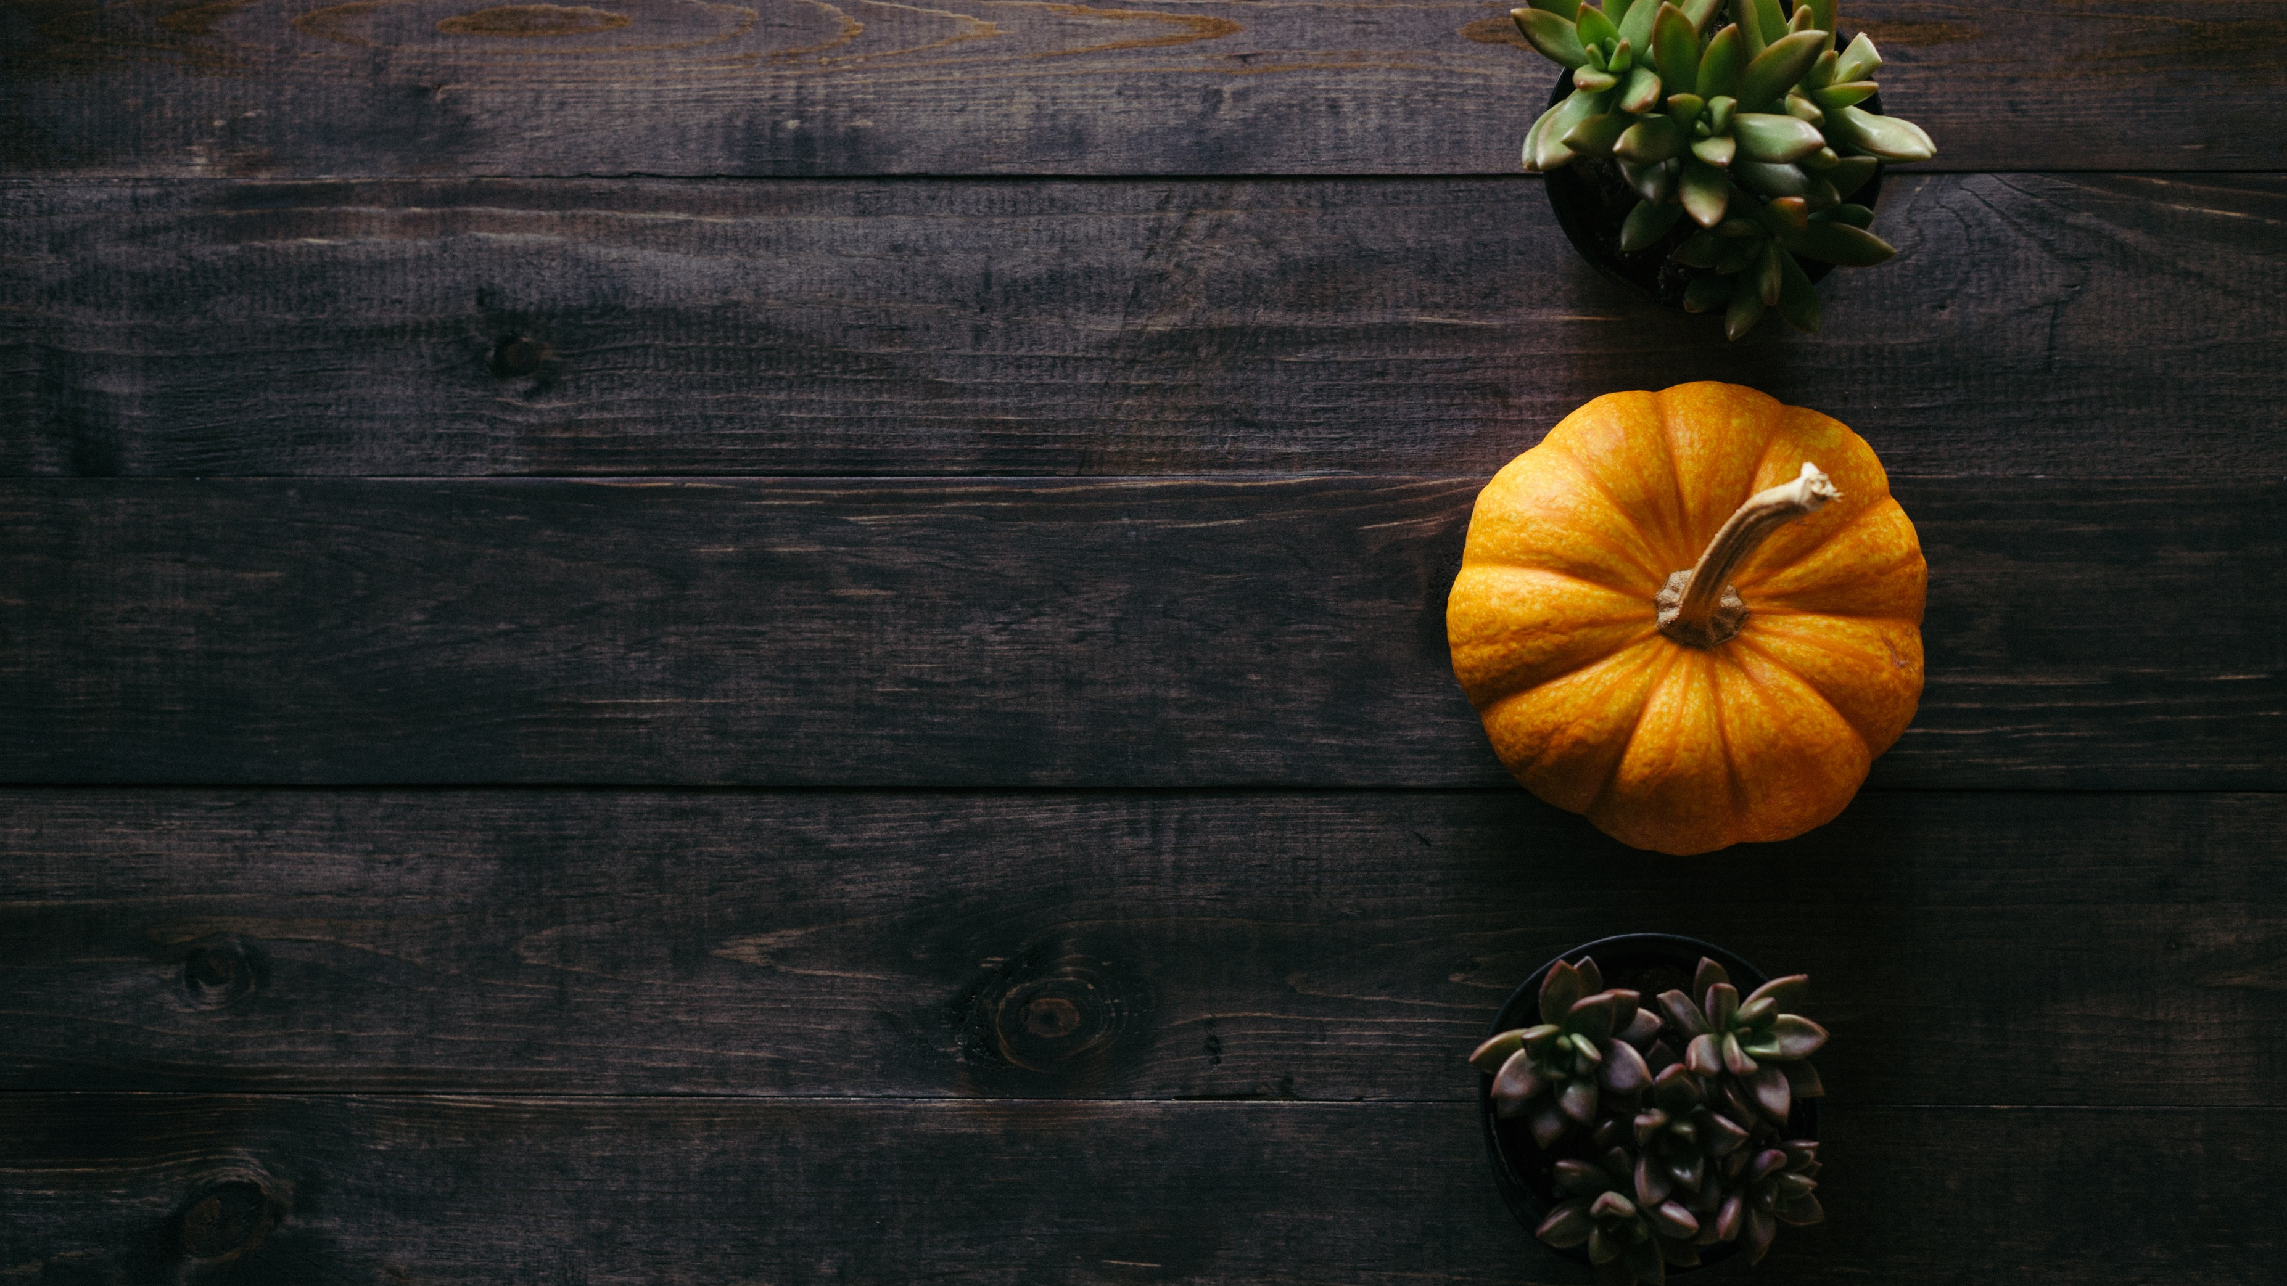
Happy Thanksgiving
Your message here

Slide 4

Have a great and wonderful
THANKS
GIVING
FROM
Mr. & Mrs. Smiths

Slide 5
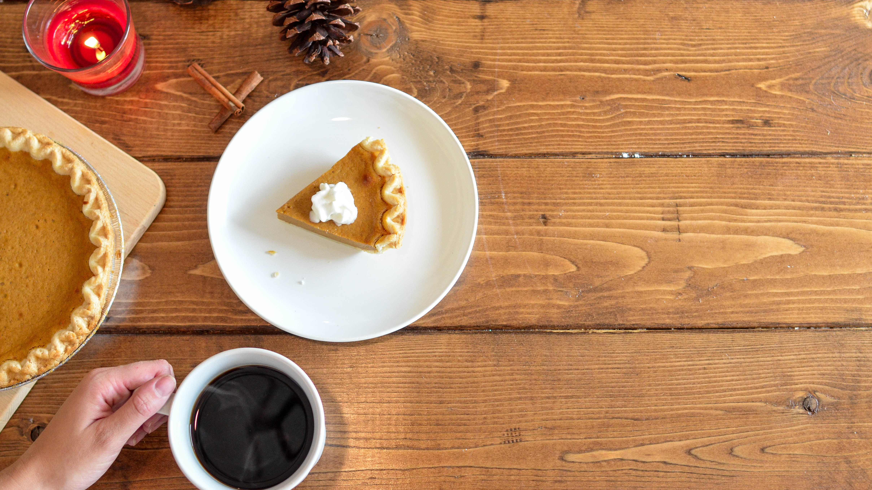
Happy Thanksgiving
Your message here

Slide 6

Have a safe and wonderful
THANKSGIVING
Your message here

Slide 7
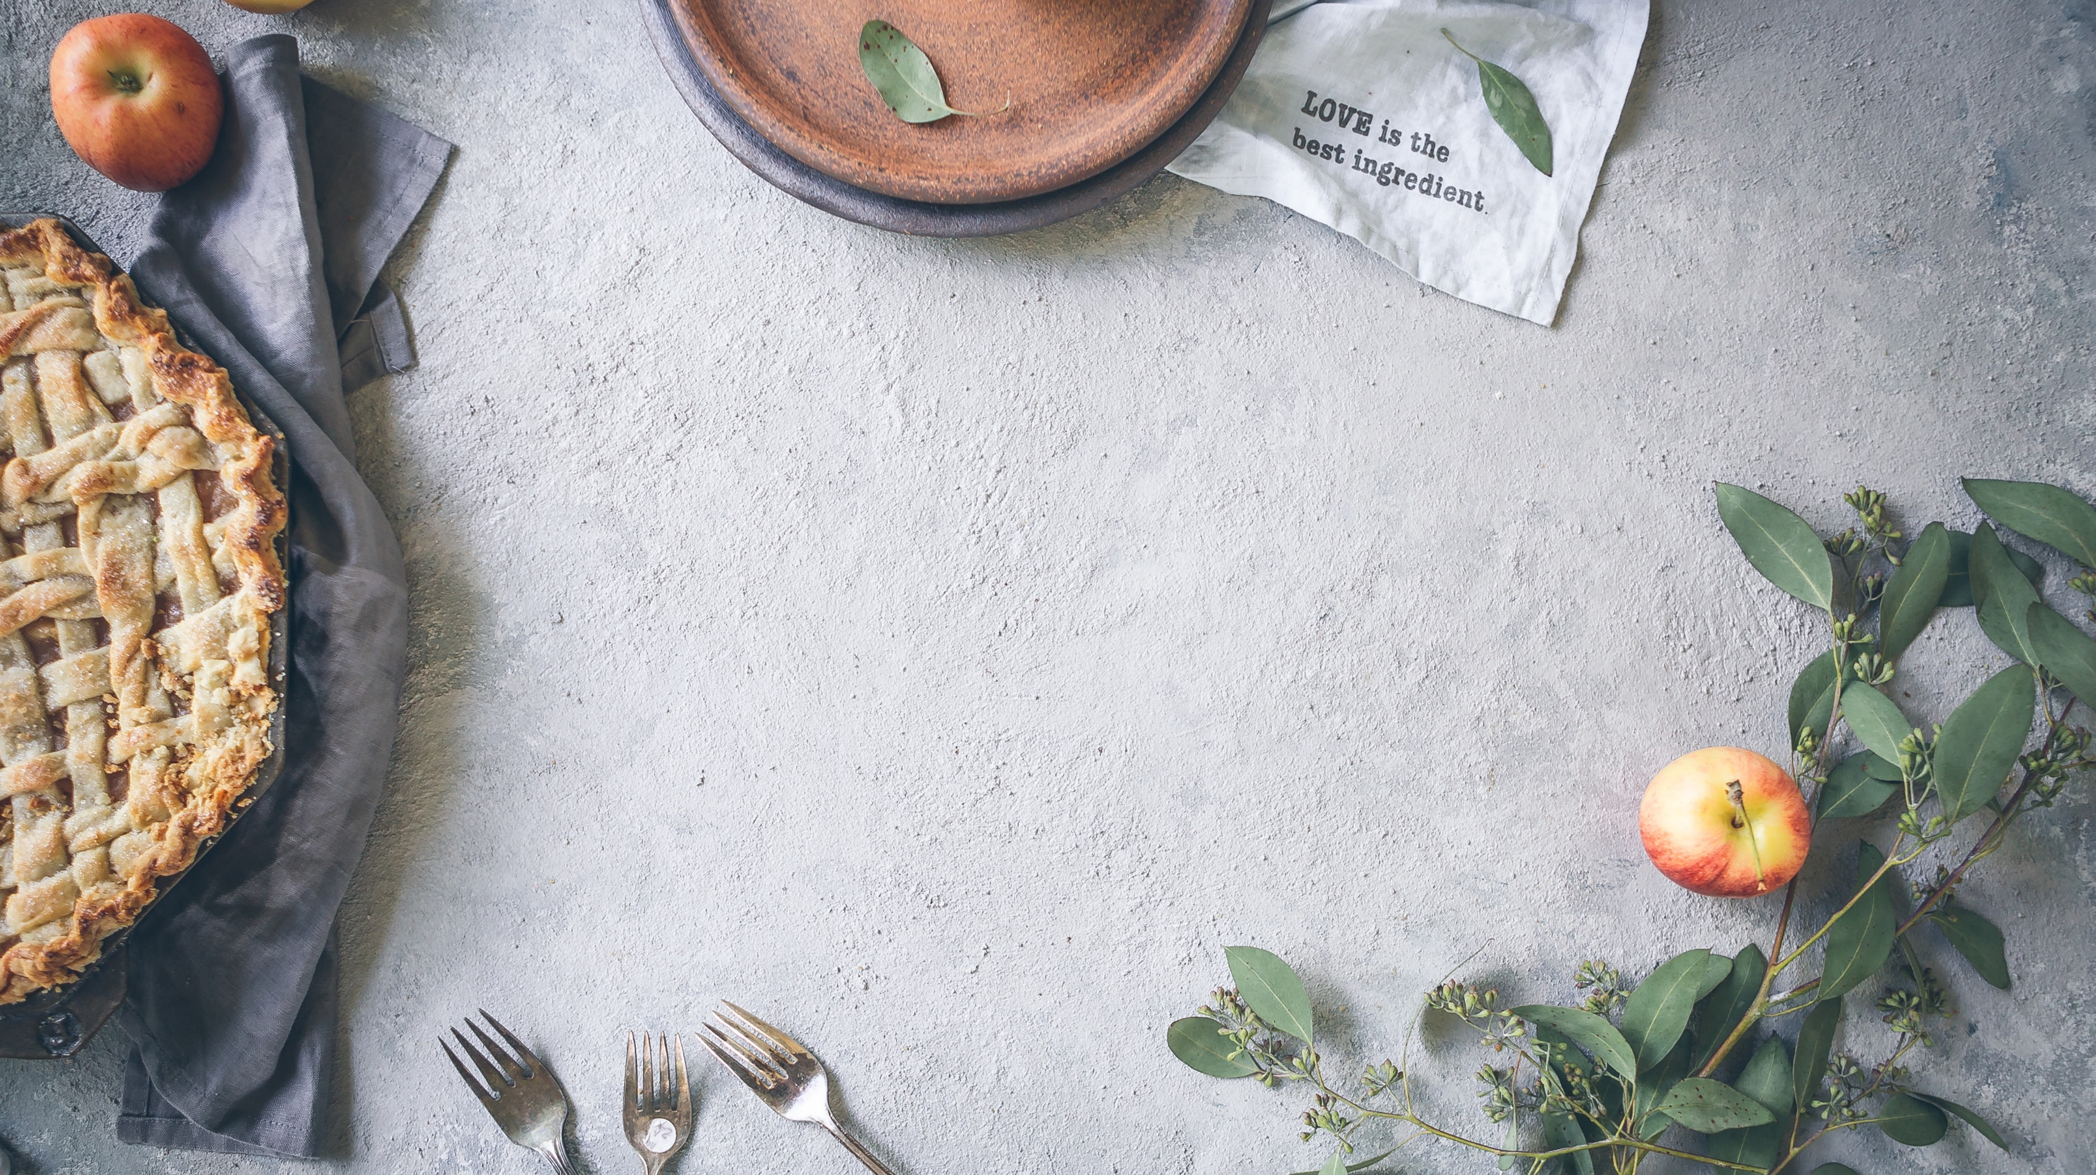
You are invited!
THANKSGIVING
FEAST
Let’s be thankful together
Nov 26 | 6PM | Location

Slide 8
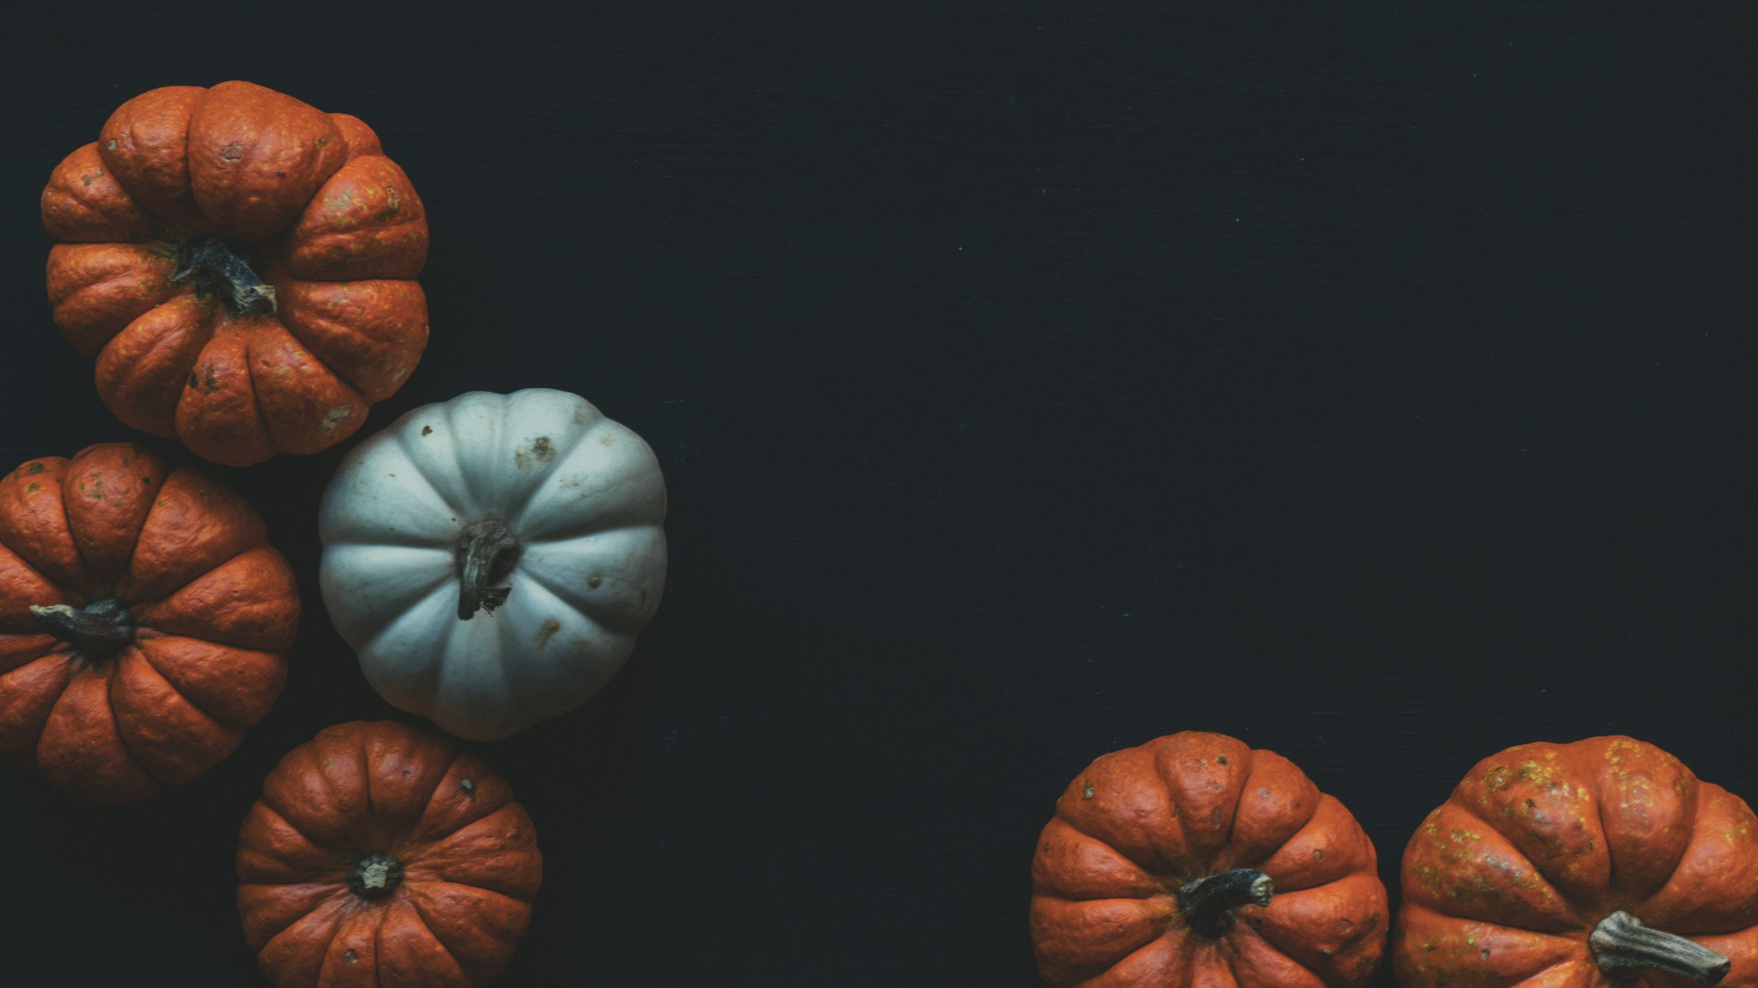
Have a wonderful
THANKSGIVING
Be Safe!

Slide 9
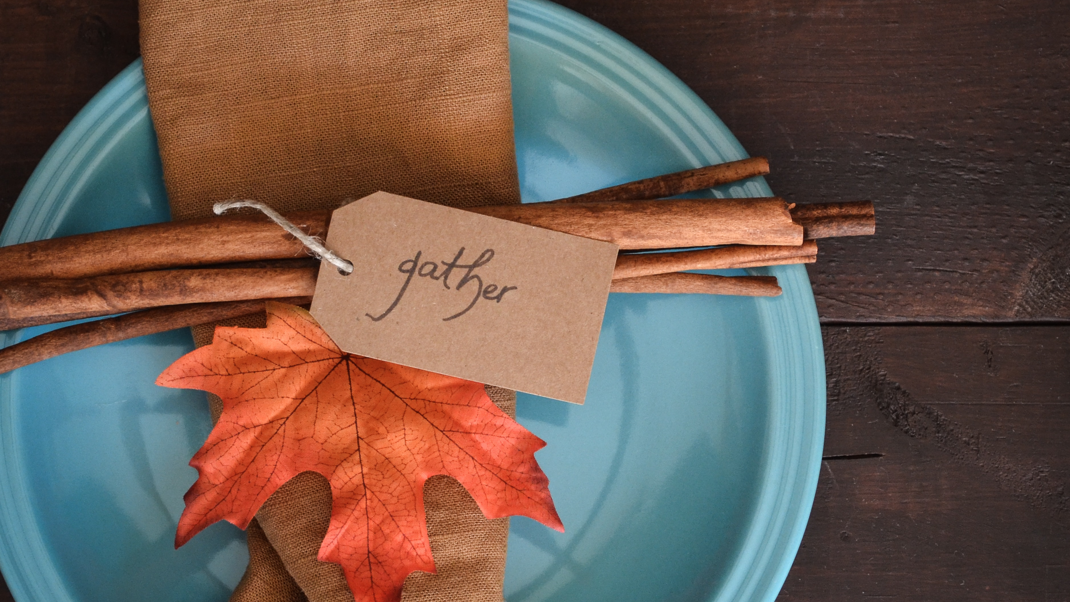
Have a Happy Thanksgiving!
Your message
here.

Slide 10


