Slide 1

Merry
Christmas
Your message here

Slide 2

You are invited!
CHRISTMAS
Feast
December 20, 2019
7-10PM
Location
Main Atrium

Slide 3

MERRY CHRISTMAS
&
HAPPY NEW YEAR
FROM
Mr. & Mrs. Smiths

Slide 4

Try our
HOLIDAY
SPECIAL
Pumpkin Latte & Velvet Cake
$10.99

Slide 5
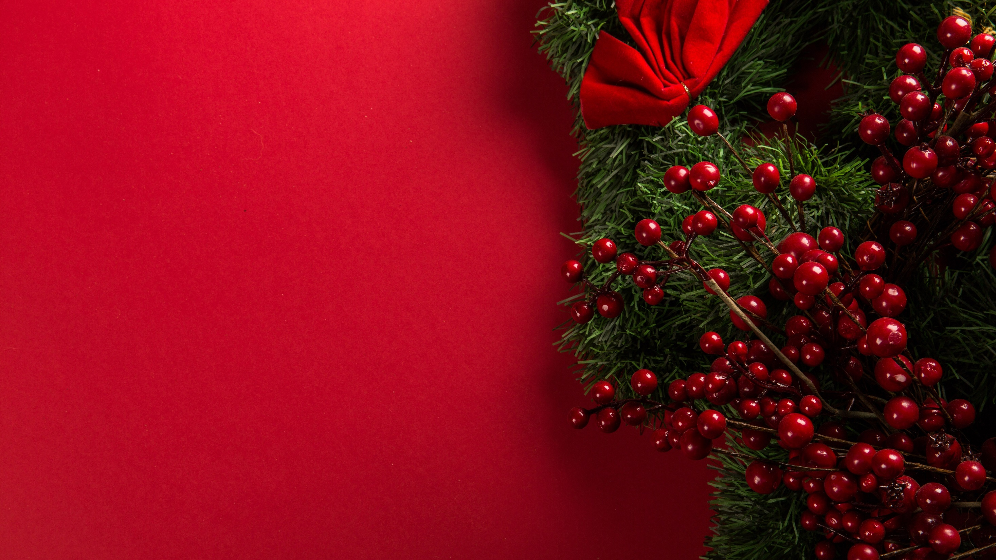
You are invited!
CHRISTMAS
Feast
December 20, 2019
7-10PM
Location
Main Atrium

Slide 6
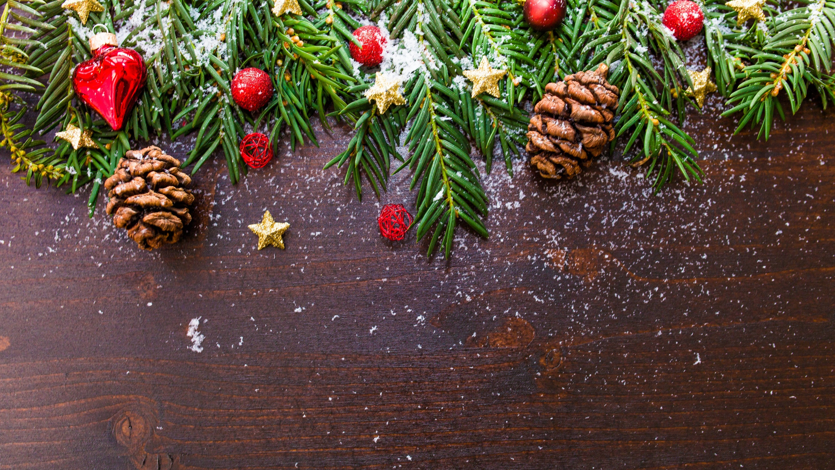
2019 CHRISTMAS
Have a wonderful

Slide 7
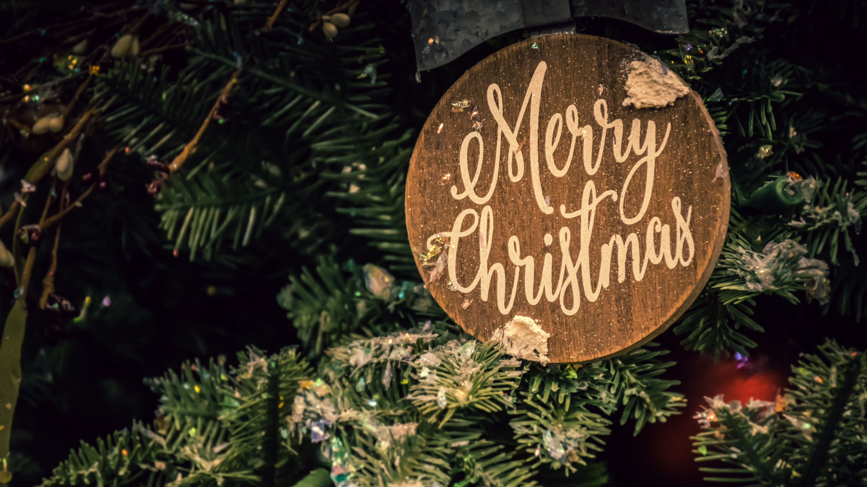

Slide 8


Slide 9

HAPPY NEW YEAR!
2020
Be Safe!

Slide 10
